Slide 1


Use of this PowerPoint presentation is limited to instructors authorized by the U.S. Concealed Carry Association.
The presenter accepts full liability for the presentation of this content.
All rights reserved. No part of this publication may be reproduced or transmitted by any means: electronic, mechanical, photocopy, recording or otherwise, without first obtaining written permission from the author.
Copyright © 2024 U.S. Concealed Carry Association
Produced with help from Andrew Nett, LCSW, Delta Defense

Slide 2
Mental
Wellness

Slide 3
Key Topics Covered
Effects of Trauma and Coping Strategies
Adverse Effects of Alcohol and Drug Use
Suicide Prevention: Education, Help and Resources
988 Suicide & Crisis Lifeline
Active-Shooter Identification
Mental Wellness

Slide 4
Effects of Trauma and Coping Strategies
Following a traumatic event, you may experience a wide range of normal responses. Clinical psychologist Patti Levin explores the physical or emotional responses, as well as coping strategies to help overcome the effects of the traumatic event.
“Such reactions may be experienced not only by people who experienced the trauma first-hand, but by those who have witnessed or heard about the trauma, or been involved with those immediately affected. Many reactions can be triggered by persons, places, or things associated with the trauma. Some reactions may appear totally unrelated.”
— Patti Levin, LCSW, PsyD
Section 1: Effects of Trauma and Coping Strategies

Slide 5
Coping Strategies
Strategies to overcome a traumatic event may include but are not limited to the following:
Crying
Laughter
Mobilizing a support system — reaching out and connecting with others, especially those who may have have experienced the same stressful event
Talking — Discuss traumatic experience with empathic listeners
Yoga
Hot baths
Stretching
Prayer
Meditation
Music and art
Credit: Patti Levin, LCSW, PsyD
Section 1: Effects of Trauma and Coping Strategies

Slide 6
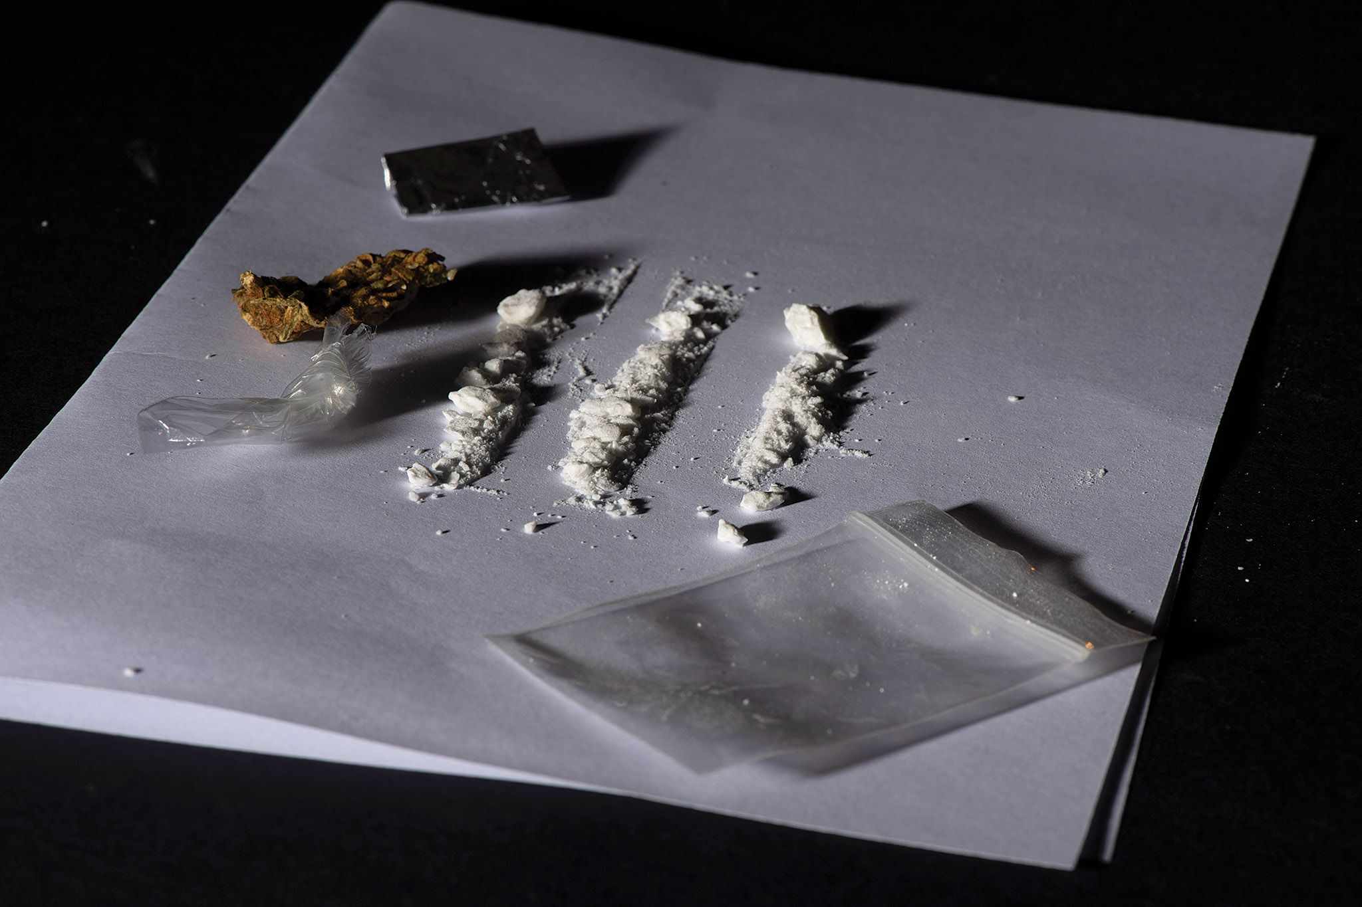
Coping Strategies
Things to avoid:
Disrupting your sleep cycle or normal diet
Overusing stimulants
Caffeine
Sugar
Nicotine
Drugs
Alcohol
Credit: Patti Levin, LCSW, PsyD
Section 1: Effects of Trauma and Coping Strategies

Slide 7

Coping Strategies
A few things to remember:
Hug the people that you love.
Love and adore your pets.
Make a daily commitment to something personally meaningful and important.
Become involved with community activities and volunteer.
Write about your experience in detail, whether it’s for yourself or to share with others.
Credit: Patti Levin, LCSW, PsyD
Section 1: Effects of Trauma and Coping Strategies

Slide 8
Emotional Responses
Emotional responses to a traumatic event may include but are not limited to the following:
Shock, disbelief, fear, anxiety, grief, shame or denial
Disorientation, hyperalertness or hypervigilance
Irritability, restlessness, outbursts of anger or rage
Emotional swings (crying and laughing)
Nightmares or flashbacks
Unpleasant memories resurfacing
Intrusive thoughts of the trauma
Credit: Patti Levin, LCSW, PsyD
Section 1: Effects of Trauma and Coping Strategies

Slide 9
Emotional Responses
Emotional responses to a traumatic event may include but are not limited to the following:
Diminished interest in everyday activities
False sense of doom or that the world is unfair
Concern over burdening others with problems
Difficulty trusting and/or feelings of betrayal
Tendency to isolate oneself
Feelings of self-blame and/or survivor’s guilt
Credit: Patti Levin, LCSW, PsyD
Section 1: Effects of Trauma and Coping Strategies

Slide 10
Emotional Responses
Emotional responses to a traumatic event may include but are not limited to the following:
Feelings of helplessness and panic or feeling out of control
Increased need to control everyday experiences
Minimizing the experience
Feelings of detachment
Attempts to avoid anything associated with trauma
Depression
Credit: Patti Levin, LCSW, PsyD
Section 1: Effects of Trauma and Coping Strategies

Slide 11

Physical Responses
Physical responses to a traumatic event may include but are not limited to the following:
Aches and pains like headaches, backaches or stomachaches
Sudden sweating and/or heart palpitations (fluttering)
Changes in sleep patterns, appetite or interest in sex
Easily startled by noises or unexpected touch
Increased use of alcohol or drugs and/or overeating
Constipation or diarrhea
Increased susceptibility to colds and illnesses
Credit: Patti Levin, LCSW, PsyD
Section 1: Effects of Trauma and Coping Strategies

Slide 12
Effects of Trauma and Coping Strategies
Traumatic reactions vary from person to person and in the length of effects.
The help and support of your family and close friends will be one of your best assets.
Some friends and family members might try to push you to move on before you are ready.
It’s OK to communicate that you appreciate their intentions but clarify that their efforts are not helpful.
Others may seek the assistance of a licensed counselor.
Remember, just because one of these methods work for one person does not mean that it will work for another.
Credit: Patti Levin, LCSW, PsyD
Section 1: Effects of Trauma and Coping Strategies

Slide 13
Adverse Effects of Alcohol and Drug Use
Alcohol and drug use can contribute to various health issues, including:
  Mental disorders
  Liver, lung or cardiovascular disease
  Cancer
  HIV/AIDS
  Stroke
  Negative health effects to family members
An increased urge and an inability to stop, resulting in an addiction
Anxiety and depression
Section 2: Adverse Effects of Alcohol and Drug Use

Slide 14
Adverse Effects of Alcohol and Drug Use
Alcohol and drug use can cause:
Slow reaction time
Impaired judgement/decision-making
Aggressive or reckless behavior
Risky sexual behavior
Drowsiness
Impaired memory
Vision problems
Dizziness
Section 2: Adverse Effects of Alcohol and Drug Use

Slide 15
Adverse Effects of Alcohol and Drug Use
Alcohol and drug use can lead to:
Motor vehicle accidents or DUIs/DWIs
Reduced inhibitions
Homelessness
Prison
Loss of family and friends
Loss of job
Section 2: Adverse Effects of Alcohol and Drug Use

Slide 16
Adverse Effects of Alcohol and Drug Use
Substance Use Facts
Brain function is reduced when using drugs for a long period of time.
Many drugs can damage nerves.
Sharing needles or unprotected sex may lead to HIV and/or hepatitis C.
Mental illness and substance use may coexist.
Mental illness may occur before drug use begins and vice versa.
Drug use can make mental health issues worse.
Treatments exist and recovery is possible.
Section 2: Adverse Effects of Alcohol and Drug Use

Slide 17
Adverse Effects of Alcohol and Drug Use
National Helpline:
1-800-662–HELP (4357)
Click here to watch the linked YouTube video: SAMHSA Hiding Places (30-Second PSA)
Section 2: Adverse Effects of Alcohol and Drug Use

Slide 18
Adverse Effects of Alcohol and Drug Use
Resources
Substance Use and Co-Occurring Mental Disorders
Substance Abuse and Mental Health Services Administration (SAMHSA)
SAMHSA Know the Risks of Using Drugs
SAMHSA Find Treatment
Navigating a Mental Health Crisis
Section 2: Adverse Effects of Alcohol and Drug Use

Slide 19
Suicide Prevention: Education
The following are truths about suicide:
Suicide is preventable.
Access to lethal means increases the risk of suicide.
Talking about suicide does not cause someone to be suicidal.
Suicide is complex, and it is a response to complex problems a person is experiencing.
Section 3: Suicide Prevention: Education, Help and Resources

Slide 20
Suicide Prevention: Statistics
According to the Centers for Disease Control and Prevention (CDC), suicide was the 11th leading causes of death in the United States in 2021.
  Second among 10- to 34-year-olds
  Fifth among 35- to 54- year-olds
In 2021, there were 48,183 suicides in the U.S.
  About one suicide every 11 minutes
Firearms were used in 55 percent of suicides.
CDC Suicide Data and Statistics
Suicide Mortality in the United States, 2001–2021
Section 3: Suicide Prevention: Education, Help and Resources

Slide 21
Suicide Prevention: Statistics
In 2021, males accounted for nearly 80 percent of suicide deaths.
Section 3: Suicide Prevention: Education, Help and Resources

Slide 22
Suicide Prevention: Statistics
Section 3: Suicide Prevention: Education, Help and Resources

Slide 23

Suicide Prevention: Risk Levels
Levels of Risk
Low: fleeting thoughts, no desire to act
Moderate: lingering thoughts, no plan, no action
High: looping thoughts, has plan, denies desire to act
Severe: looping thoughts, lethal plan and desire to act
If a suicide attempt seems imminent, call a local crisis center, phone your country’s emergency services number (911 in the U.S.), or take the person to an emergency room. Remove guns, drugs, knives and other potentially lethal objects from the vicinity but do not, under any circumstances, leave a suicidal person alone.
Section 3: Suicide Prevention: Education, Help and Resources

Slide 24
Suicide Prevention: Warning Signs
Warning Signs
Talking about:
  Wanting to die
  Intense guilt and shame
  Being a burden to others
Feeling:
  Empty, hopeless or trapped
  Extreme sadness, anxiety, agitation or rage
  Overwhelming emotional or physical pain
Change in behavior:
  Researching or making plans to die
  Withdrawing from friends and family, saying goodbye, giving away important items
  Taking dangerous risks
  Displaying mood swings
  Eating or sleeping more or less
  Using drugs and alcohol more often
Section 3: Suicide Prevention: Education, Help and Resources

Slide 25
Suicide Prevention: Risk Factors
Risk Factors
Psychological:
  Hopelessness, low self-worth, impulsivity, loneliness/isolation
Environmental:
  Access to lethal means, prolonged stress, life events (divorce, finances, job loss, homelessness), exposure to suicide
Health:
  Mental health conditions, physical injury/ongoing pain, traumatic brain injury (TBI)
  Historical:
  Previous attempts, family history, childhood abuse, neglect or trauma
Section 3: Suicide Prevention: Education, Help and Resources

Slide 26
Suicide Prevention: Protective Factors
Protective Factors
Identifies a purpose for living
Connection to family and friends
Access to mental health care
Religious/cultural beliefs that encourage life
Future/goal-oriented
Engages in work and school
Strong distress tolerance
Section 3: Suicide Prevention: Education, Help and Resources

Slide 27
Suicide Prevention: Intervention Methods
Intervention Methods
Ask questions
Listen and support
  Encourage talking
Separation from lethal means
Encourage professional help
  Decrease the stigma
Section 3: Suicide Prevention: Education, Help and Resources

Slide 28

Suicide Prevention: Education, Help and Resources
Walk the Talk America (WTTA)
WTTA’s mission has been to reduce firearm suicides and other negative incidents associated with firearm ownership through education, outreach, and engagement with the firearms and mental health industries.
More information can be found by visiting:
WalktheTalkAmerica.org
Section 3: Suicide Prevention: Education, Help and Resources

Slide 29
Suicide Prevention: Education, Help and Resources
Walk the Talk America (WTTA):
Is dedicated to bridging the gap between mental health and gun ownership
Partners with experts in the firearms and mental health industries
Breaks the negative stigmas around mental health for firearm owners
Trains mental health professionals for the 2A community
Operates a national directory of mental health professionals
Partners with Mental Health America to offer free, anonymous mental health screenings
Resources
Section 3: Suicide Prevention: Education, Help and Resources

Slide 30
Suicide Prevention: Education, Help and Resources
Resources and Safety Planning
988 is a crisis hotline (Call 911 if someone is in a life-threatening situation resulting from a suicide attempt, like bleeding out, overdosing, not breathing, etc.)
Local hospitals
Primary care doctor
Department of Health and Human Services
Local counseling services (SAMHSA treatment facility finder)
Section 3: Suicide Prevention: Education, Help and Resources

Slide 31
Suicide Prevention: Education, Help and Resources
Resources and Safety Planning
Mental Health America Screening
American Foundation for Suicide Prevention (AFSP)
AFSP Risk Factors, Protective Factors and Warning Signs
AFSP Talk Away the Dark
Reduce Access Reduce Suicides
National Alliance on Mental Health (NAMI) Statistics
Section 3: Suicide Prevention: Education, Help and Resources

Slide 32

988 Suicide & Crisis Lifeline
The 988 Lifeline provides 24/7, free and confidential support to people in suicidal or emotional distress.
The national network comprises more than 200 local crisis centers.
Call 1-800-273-8255 (English) or 1-888-628-9454 (Spanish).
When you call, a trained crisis worker will listen to and understand your problem, and he or she will provide support and helpful resources.
To learn more, please visit 988Lifeline.org/.
Section 4: 988 Suicide & Crisis Lifeline

Slide 33
988 Suicide & Crisis Lifeline
988 Text Line
Text 988 on your mobile device and complete a short survey to inform the counselor about your situation.
When you text, a trained crisis worker will listen to and understand your problem, and he or she will provide support and helpful resources.
Section 4: 988 Suicide & Crisis Lifeline

Slide 34
Active-Shooter Identification
The FBI has compiled a quick reference guide of concerning (observable) behaviors displayed by active shooters between 2000 to 2013, such as:
Leaking plans or ideas (56 percent)
Reduced work (46 percent) or school (42 percent) performance
Threatens or confronts others (35 percent)
Anger and/or physical aggression (33 percent)
FBI Pre-Attack Behaviors of Active Shooters Quick Reference Guide
Section 5: Active-Shooter Identification

Slide 35
Active-Shooter Identification
The FBI has compiled a quick reference guide of concerning (observable) behaviors displayed by active shooters between 2000 to 2013, such as:
Unusual firearms behavior (21 percent)
Violent media usage (19 percent)
Drug (13 percent) and/or alcohol (10 percent) abuse
Physical health (10 percent)
Other abnormal behavior, like idolizing criminals (8 percent)
Indifference to hygiene and appearance (3 percent)
FBI Pre-Attack Behaviors of Active Shooters Quick Reference Guide
Section 5: Active-Shooter Identification

Slide 36
Active-Shooter Identification
The FBI also compiled a list of grievances held by active shooters between 2000 to 2013, such as:
Adverse interpersonal action against the active shooter (33 percent)
Adverse employment action against the active shooter (16 percent)
Other, like general hatred of others (10 percent)
Adverse governmental action against the active shooter (3 percent)
Adverse financial action against the active shooter (3 percent)
Hate crime (3 percent)
Unknown/no grievance identified (21 percent)
FBI Pre-Attack Behaviors of Active Shooters Quick Reference Guide
Section 5: Active-Shooter Identification

Slide 37
Active-Shooter Identification
The Department of Homeland Security has compiled a list of ways to ensure safety for yourself and others:
Be aware of drastic changes in attitude toward others.
Take note any escalations in behavior and report it to your supervisor/proper authorities.
Provide information to:
  Help facilitate intervention
  Mitigate potential risks
Know when to run, hide or fight.
Department of Homeland Security Active-Shooter Attacks
Section 5: Active-Shooter Identification

Slide 38
Key Topics Covered
Effects of Trauma and Coping Strategies
Adverse Effects of Alcohol and Drug Use
Suicide Prevention: Education, Help and Resources
988 Suicide & Crisis Lifeline
Active-Shooter Identification
Mental Wellness

Slide 39
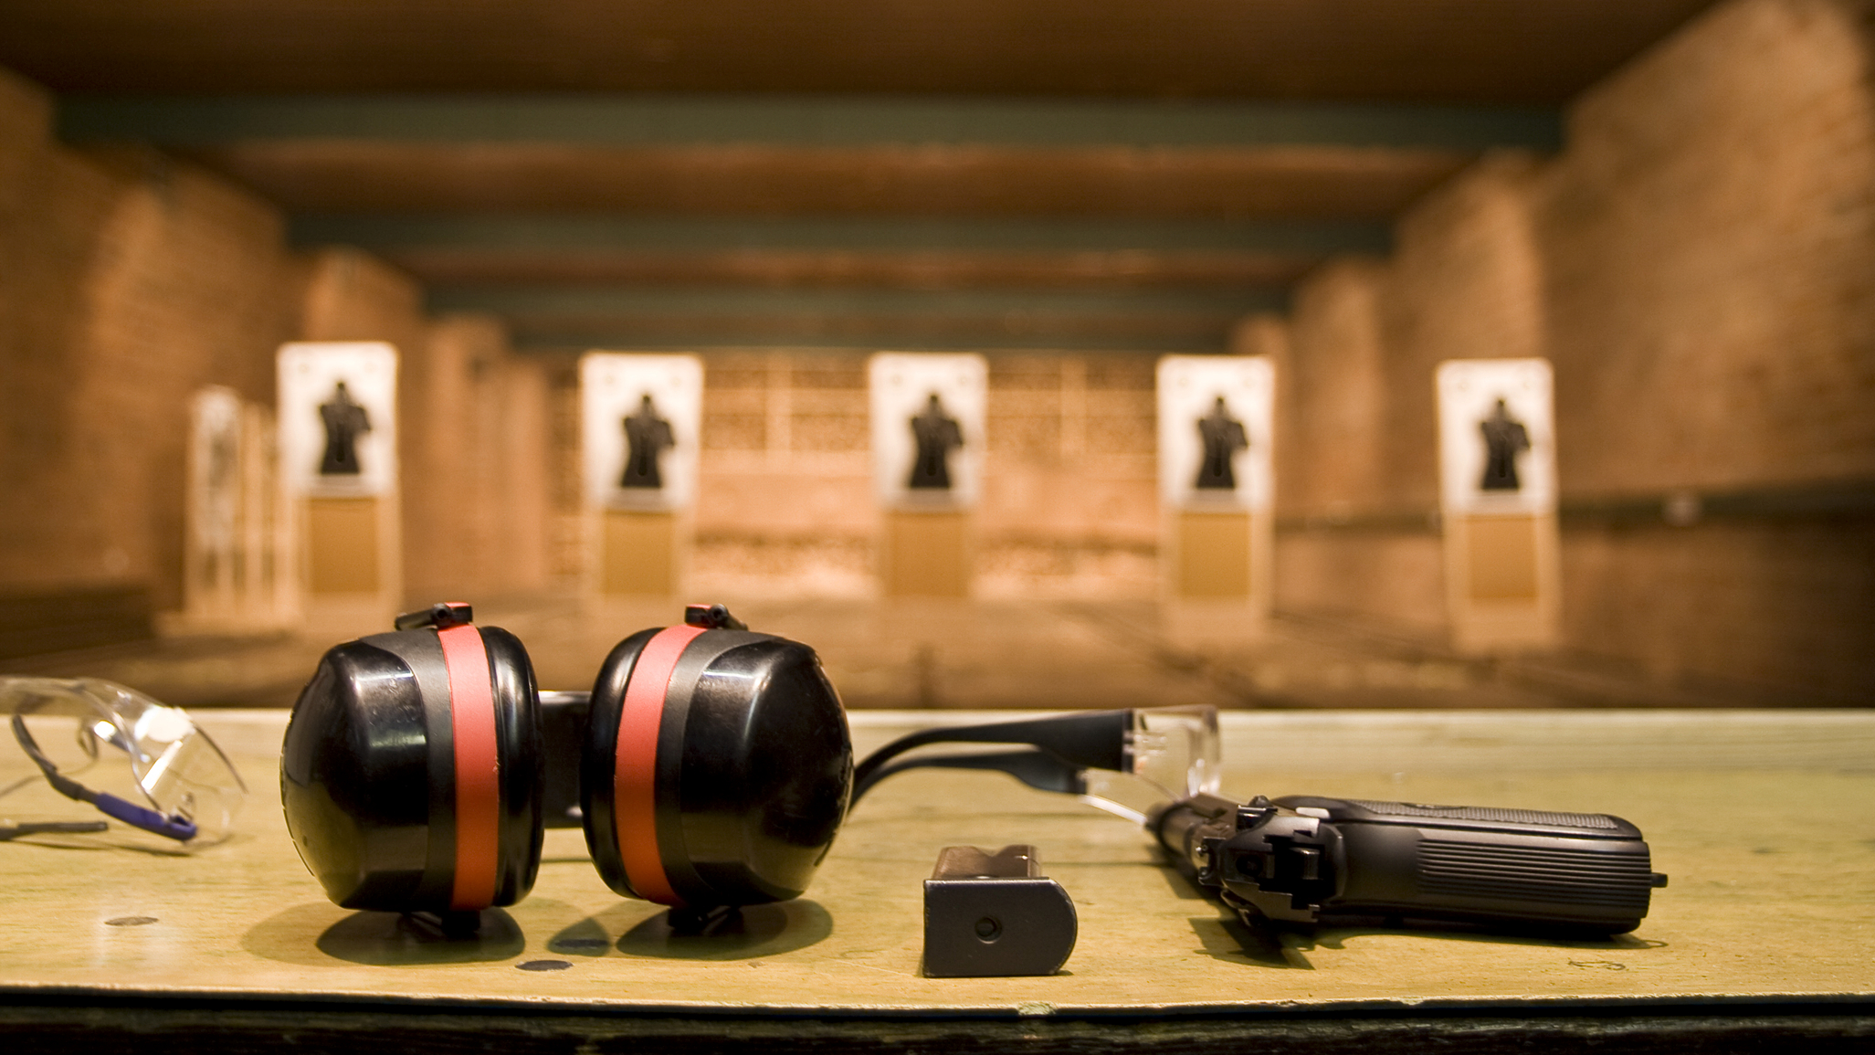
Questions?

